Slide 1
ADAPTER
Target Market :
IT industry in Machine Learning.
Value Propositions:
Solution to a problem when the data set is too large to be processed in a single computing system.
Team:
Divya Davat
Lakshmi Prasanna
Surya Vamshi Teja Davat
Hashmitha Solipuram
Venkata Sai Teja Annam

Slide 2
Problem Statement
We would be implementing a project to provide a simple solution to the problem arises when a covid data set is too large to be processed on a single computing system.
The main idea is to process and distribute over multiple datasets and also check for duplicates in that particular dataset.

Slide 3
Approach
The solution is based on the idea of checking the county value of each data instance of covid data set and assigning it to a particular computing system. We will always assign the instances of a particular county to the same computing system and therefore we can recognize the duplicates.
We can also be sure that the duplicate wasn't assigned to some other computing system, other than the one containing the initial value.

Slide 4
Features
The design was created in such manner that we can easily replace, for example, File Handler that handles JSON format with some handler that handles CSV or XML files.
Handle invalid characters in the file during conversions.
Can retrieve only specific fields required from whole data set.
Works for different state covid data sets.

Slide 5
Justifications
The software we are going to use for the development is cost-free.
IDE used: eclipse, Languages: JAVA
The splited datasets can be used individually for analysis.
Libraries: Spring Beans, Spring Web, GSON, Rest API
Front end Technologies: HTML,CSS,JS
By using the above technologies we implemented the idea.

Slide 6
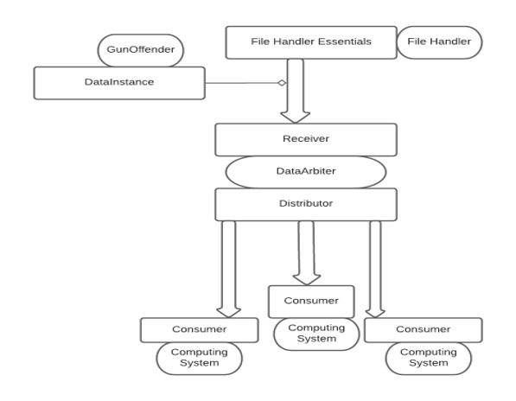
Business Model

Slide 7
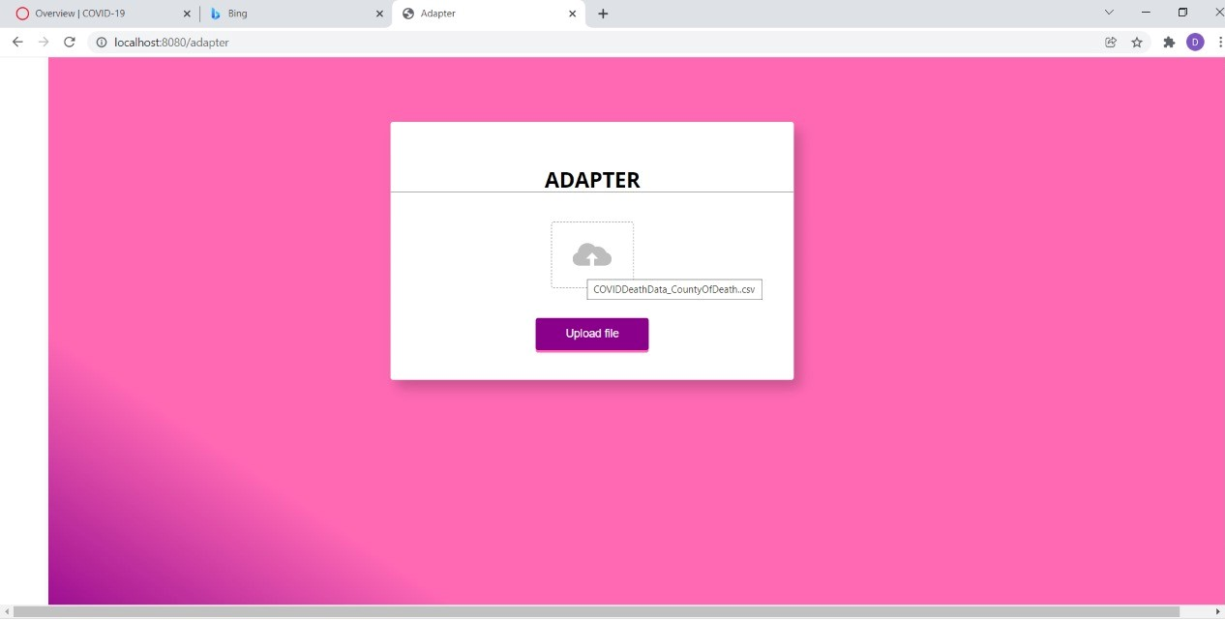
Starting Up

Slide 8
video

Slide 9
How to make money
It would be mainly used by the data analyst who are working on covid predictions.
Our project mainly deals with data split of a huge data set into many systems this is required by many software developers, students as the time taken to process a huge data set on a single system would take too long to process on a single system.

Slide 10
Our Team and Contributions
Divya Davat- Functionality for splitting the dataset based according to counties based on mapping of county and computing system specified in properties file
Hashmitha Solipuram- Testing unit testing manual testing and management
Lakshmi Prasanna Meduri- conversions
Surya Vamshi Teja Davat- UI using html css and rest api
Venkata Sai Teja Annam- Interfaces controllers and API development

Slide 11
Future Implementation
We made an initial prototype of the project considering the covid Ohio data set.
We would be exposing 2 API's for dataset upload and split datasets.
We have implemented specifically for OHIO covid dataset, we would be adding a functionality to replace the properties file which is state specific so that it can be used by all states COVID data in United States.

